Slide 1
Linking gymnastics to other lessons: -
Here are a few examples, but I’m sure that you could include any topic!
EG. You might be talking about animals in class – I have included a variety of animals in the stretches.
If you show the slides as you are teaching your lesson, the children will see a picture of the animals and will also see the spellings.

Slide 2
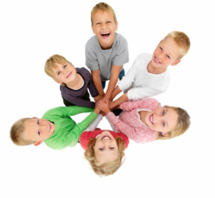
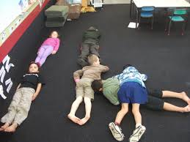
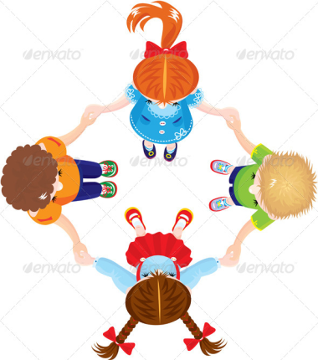
NUMBERS
Moving around the gym -
Teacher shouts “stop” then says a number – children get into groups of that number.
Develop this by doing addition (2+4 = groups of 6) or – or X or ÷
3. Alternatively, children could make the shape of the number
SHAPES
Moving around the gym - you choose OR you choose the first way and then whichever
child does it the best, gets to choose how everyone moves.
Teacher shouts “stop” then says a shape
Children make the shape on their own/with partner/group
The shape might be decided by the number called (3s = triangle)
Children could stand or lie on the floor
Fast/slow
High/low
Different body parts
Skipping/walking/side stepping/high knees/Russian soldier etc

Slide 3
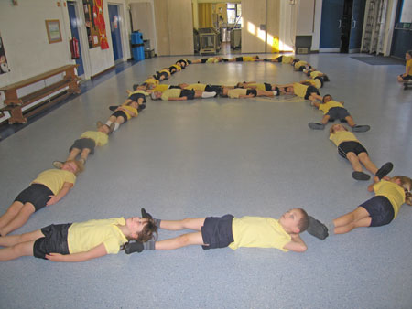
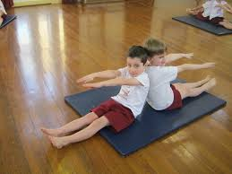
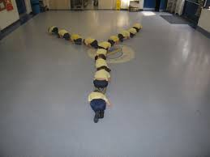
LETTERS
Moving around the gym - you choose all the time OR you choose the first way and then whichever child does it the best, gets to choose how everyone moves.
Teacher shouts “stop” then says a letter. Children can make the letter on their own or
teacher tells them to work with a partner or in a small group.
Letters can be lower case or capitals.
Children can be on the floor or standing
Words can be spelt out
Children can make up their own letters/words and others have to guess what they are.
The whole class could make one shape
You can do the same with numbers

Slide 4

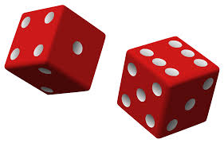

TELLING THE TIME/POINTS OF THE COMPASS
Travel around gym. On teacher’s command, go to 5 o’clock.
Spots could be used to show where each hour should be.
¼ past, ½ past and ¼ to could then be introduced.
Split the group in half so they have to go to the o’clock or the past/to.
A non doer could roll 2 dice and then call out the hour that the others have to travel
towards.
This can also be used to help children remember the points of the compass.

Slide 6
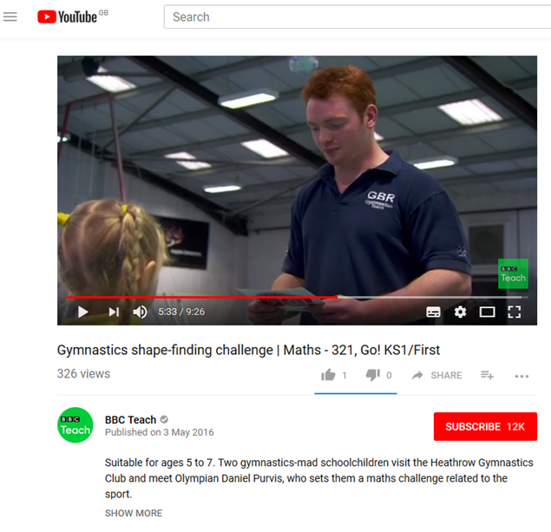
Maths and gymnastics
Suitable for ages 5 to 7. Two gymnastics-mad schoolchildren visit the Heathrow Gymnastics Club and meet Olympian Daniel Purvis, who sets them a maths challenge related to the sport.
https://www.youtube.com/watch?v=HJJ7x3BI4iE
Start watching after 5.30 minutes

